Slide 1



CEG FABLESS RISC-V SUMMER INTERNSHIP
TEAM ID: CF-RV-25-11
TEAM MEMBERS: RAMYA S
MRUTHULA R

Slide 2
PROJECT STATEMENT:
C-Class core performance analysis: L1 I-Cache and D-Cache. Vary some configuration knobs in the parameter files and evaluate on risc-v benchmarks, coremark and other microbenchmarks given by Shakti team. Compare performance across configs.

Slide 3
This project focuses on analyzing the performance of the Shakti C-Class RISC-V core by varying configuration parameters of the Level-1 Instruction Cache (I-Cache) and Data Cache (D-Cache). By modifying cache-related knobs such as associativity, block size, and replacement policies in the parameter YAML files, we evaluate their impact on core performance. The analysis is conducted using standard RISC-V benchmarks, CoreMark, and microbenchmarks provided by the Shakti team. Performance metrics are collected and compared across multiple configurations to identify optimal cache settings for improved efficiency and speed.
ABSTRACT:

Slide 4
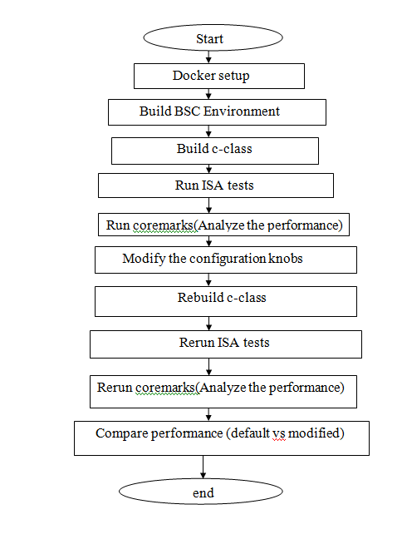

Slide 5
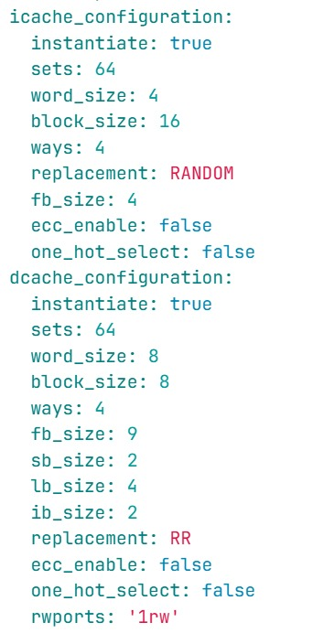
DEFAULT CONFIGURATION:

Slide 6
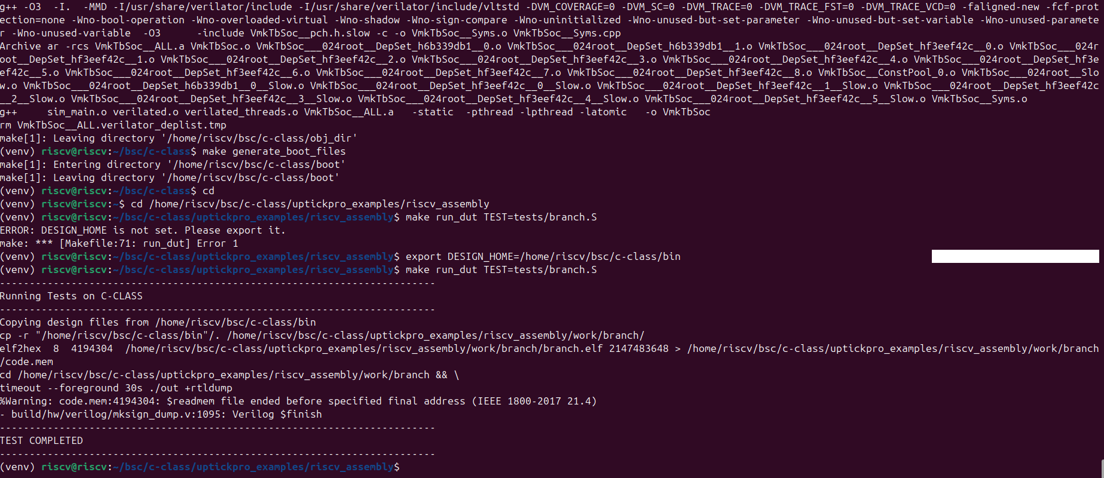
ISA TEST:

Slide 7
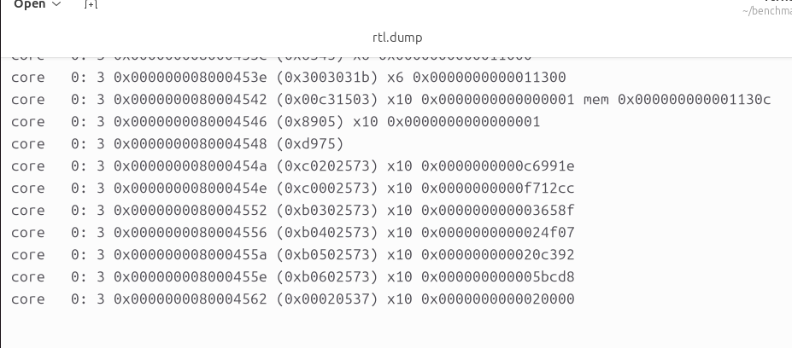
RTLDUMP FILE:

Slide 8
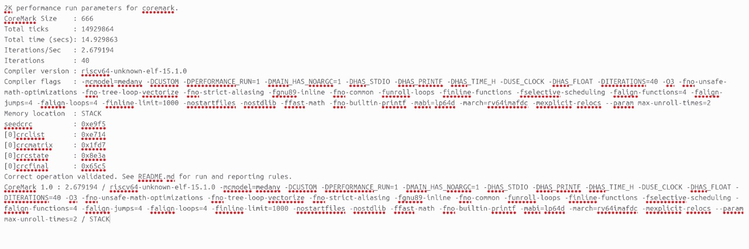
APPLOG FILE:

Slide 9
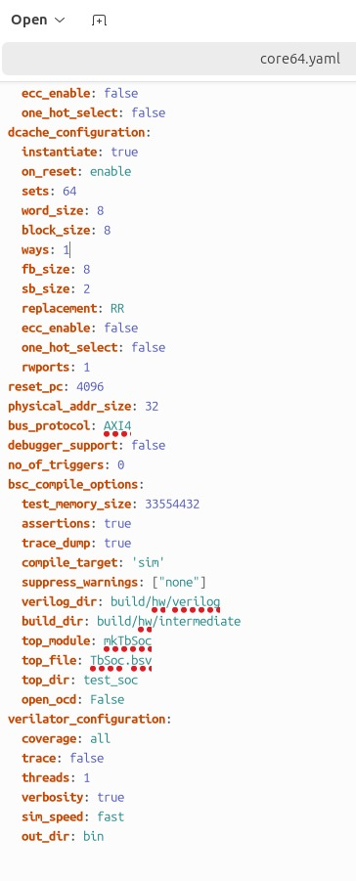
MODIFIED CONFIGURATION:

Slide 10

THANK YOU
10

